Slide 1
Research Computing Update
March 2021

Slide 2
HPC Resources
New HPC Procurement via ANKABUT
Continued delays to launch due to missing identity management system at KU. Currently being worked on and expect test users early May.
Masdar Datacentre resources HPC Cluster
Big push to vacate Masdar Datacentre, though no solid date given.
Working with IT/Ankabut to vacate as soon as possible
SAN HPC Cluster
Quote for the decommissioning of hardware with ADNOC now, awaiting their decision. No update from ADNOC.

Slide 3
Resource Utilization

Slide 4
KU Cluster core distribution

Slide 5
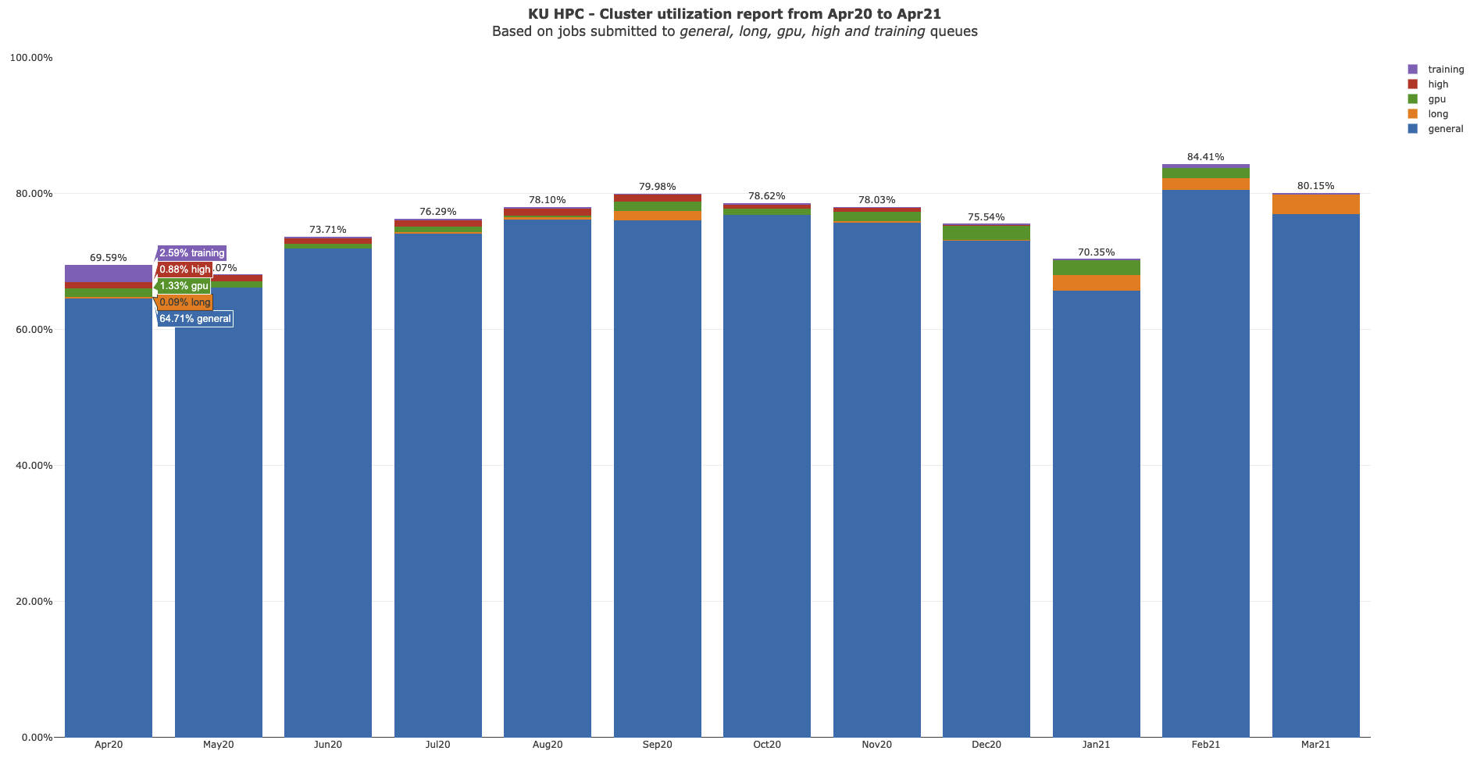

Slide 6
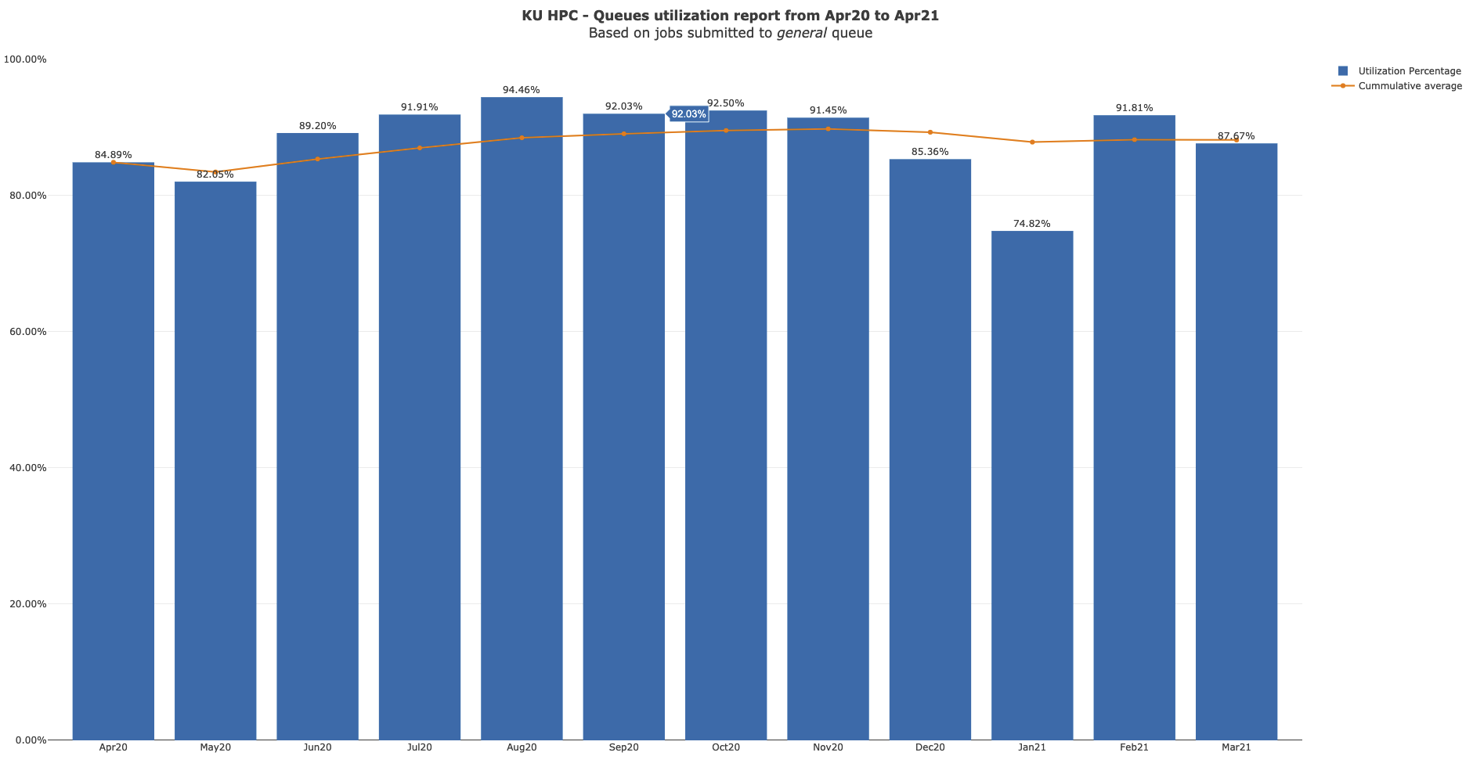

Slide 7
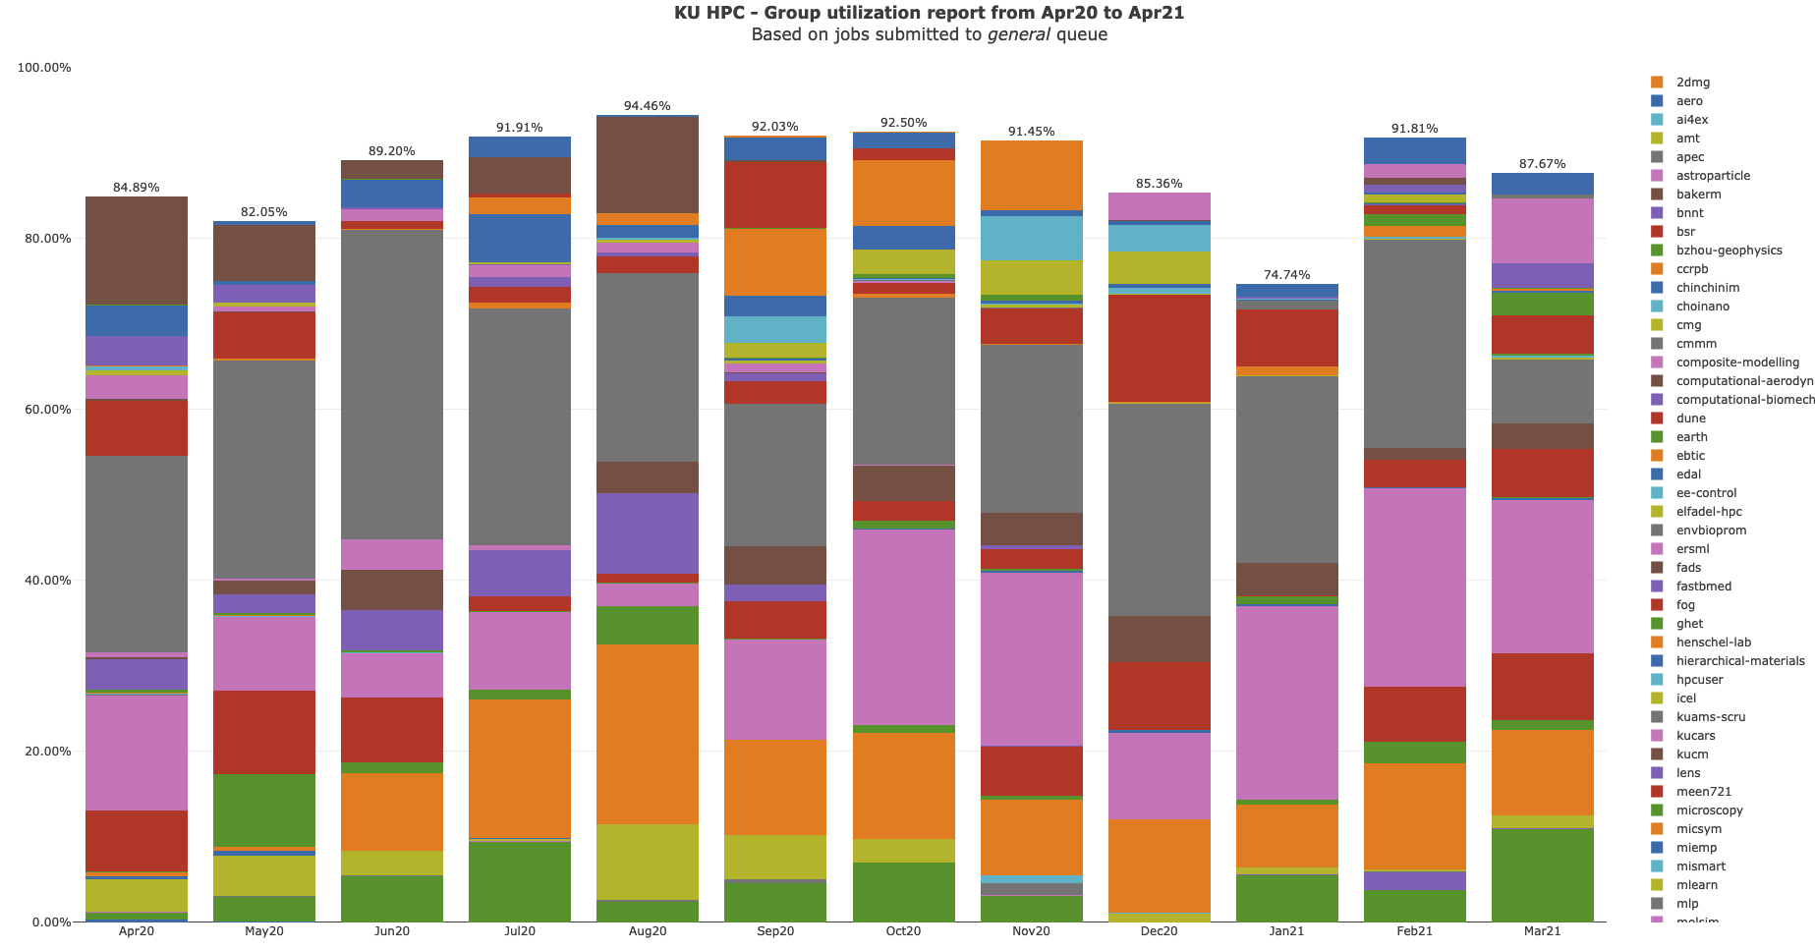

Slide 8
KU HPC Group Utilization for March 2021.
Groups were created under PI names, some of which have left KU, though the group remains. There is no link directly between HPC accounts and HR data. That is being worked on for the new cluster.

Slide 9
PI Cluster core distribution

Slide 10
